Slide 1
Today We Launch SAIL! (Presentations will begin at 12:10 pm)

Slide 2
Seahawks Advancing Interdisciplinary Learning
Goal: to use interdisciplinary learning to improve undergraduate student learning about critical thinking, diversity, and global issues
Critical Thinking
Diversity
Global Citizenship
Interdisciplinary Learning

Slide 3
QEP Advisory Board
Interim Associate Provost for Undergraduate Education & Faculty Affairs (Michelle Scatton-Tessier)
QEP Director (Beverley McGuire)
QEP Assistant Director (Erica Noles)
Director of Institutional Effectiveness (Kim Miller)
General Education Assessment Coordinator (Lea Bullard)
Director of the Center for Teaching Excellence (Jacquelyn Lee)
One associate dean/faculty with previous administrative experience from:
Cameron School of Business (Dave Glew)
College of Arts and Sciences (Kemille Moore)
College of Health and Human Services (Lorie Sigmon, Nursing)
Watson College (Angela Housand)
One faculty member from each of the four colleges/schools:
College of Arts and Sciences (Jennifer Biddle)
College of Health and Human Services (Alicia Sellon, Social Work)
Watson College of Education (Amy Garrett-Dikkers)
Cameron School of Business (William Compton)
Randall Library representative (Stephanie Crowe)
Student Affairs member (Will Wilkinson)
Faculty Senate Steering Committee Member (Kristin Bolton)
Director of Applied Learning (James DeVita)
Director of Honors College (Eva Mehl)
University College representative (Michelle Vliem)
Communication and Marketing Coordinator, Academic Affairs (Megan Kauzlaric)
Community Member/Alumni representative (Wanda Coley)
Advancement representative (Katie Crosby)
Alumni Affairs representative (Lindsay LeRoy)

Slide 4
Major Components of Plan
Large Team Grants ($50K per team, 3 per year)
Small Team and Individual Grants ($5K per member, 20 per year)
Faculty Fellows (who organize interdisciplinary learning workshops, review grant applications, assess students’ signature work)
Interdisciplinary Learning Workshops
Connect & Collaborate Sessions
Student Interdisciplinary Learning Showcase

Slide 5
QEP Activities in Fall 2023

Slide 6
Apply to be a SAIL Faculty Fellow!
Apply on our SAIL Canvas site by September 15
$3,000 stipend for September 2023 – June 2024 to:
Assess students' interdisciplinary work
Select next year's recipients of large team, small team, individual awards
Offer one workshop tied to interdisciplinary learning
Upload CV and statement of interest to Canvas Site!
Note: being a SAIL faculty fellow does not preclude you from applying for a large team, small team, or individual award!

Slide 7
2023-2024 Activities
QEP Faculty Fellows for 2023-2024 (application due September 15!)
Connect and Collaborate sessions (organized by topic/question)
Interdisciplinary Learning Workshops
Selection of Large Team Awardees for 2024-2027 ($50K total)
Selection of Small Team Awardees for 2024-2025 ($5K per member)
Selection of Individual Awardees for 2024-2025 ($5K)
Student Showcase in Spring of 2024

Slide 8
Large Team Grants Awarded 2023-2026
Interdisciplinary approaches to information and digital literacies
Faculty and staff across four colleges, from English, Instruction Technology, Psychology, Public Health, and Randall Library
An Interdisciplinary Approach to End-of-Life Education on Our Campus and within Our Community
Faculty across two colleges, from Gerontology, Philosophy, Psychology, and Respiratory Therapy
Critical AI: Enhancing Critical Thinking Through Interdisciplinary Learning About Artificial Intelligence
Faculty and staff across all five colleges and schools, from Art Education, Computer Science, English, Information Systems and Operations Management, Nursing, Management Information Systems, Randall Library, and Special Education

Slide 9
Interdisciplinary Approaches to Information and Digital Literacies
Develop Canvas content providing resources and instruction in critical information and digital literacies
Create assignments to deploy across paired courses from different disciplines that ask students to work together to solve a problem related to information and critical digital literacies
Provide professional development for faculty to create assignment prompts targeting information and critical digital literacies
Sponsor speakers from across disciplines to address the campus community related to information and critical digital literacies

Slide 10
An Interdisciplinary Approach to End-of-Life Education
On Our Campus and Within Our Community
Alissa Dark-Freudeman
Psychology
Jamy Chulak
Respiratory Therapy
Elizabeth Fugate-Whitlock
Gerontology
Kirsten Kringle-Baer
Philosophy
Tina Newsham
Gerontology

Slide 11
An Interdisciplinary Approach to End-of-Life (EOL) Education
On Our Campus and Within Our Community
Fall 2023
Create Online Interdisciplinary Canvas Module (OICM).
Spring 2026
Continue the OICM.
Beyond…
Students continue to identify, develop, and implement new outreach projects based on community needs.
Spring 2025
Continue the OICM.
Continue OICM.
Continue OICM.
Continue DIS project:
Students will develop an outreach project to formally launch online ACP resources in the community.
Continue DIS project:
Students will implement the outreach project, collect and evaluate assessment data, and report to community partners.
Fall 2024
Fall 2025
Spring 2024
Launch OICM within our respective classes and assess student learning outcomes.
PSY, RSP, GRN, PAR
Host first interdisciplinary panel to discuss different perspectives on EOL and Advance Care Planning (ACP).
Initiate DIS project: Students interview community partners to identify attitudes and barriers to ACP.

Slide 12
An Interdisciplinary Approach to End-of-Life Education on Our Campus and within Our Community
Develop Online Interdisciplinary Canvas Module (OICM) integrating perspectives on End-of-Life and Advance Care Planning into four courses (GRN101/440, PAR215, PSY449, and RSP210/306)
Form student teams that interview community partners (e.g., healthcare professionals, residents of local assisted living facilities, community members) to assess current attitudes toward and perceived barriers to Advance Care Planning

Slide 13
Critical AI: Enhancing Critical Thinking Through Interdisciplinary Learning About Artificial Intelligence
Develop and teach interdisciplinary courses on the impacts of AI (CSC 432, ENG 390, EDN 492, HON 210)
Develop online course deliverables including Canvas modules that examine the impacts of AI in various disciplines (AI and literature, AI and information literacy, AI and ethics, AI and organizational policy)
Collaborate on AI-related campus events and activities including an AI art exhibit, workshops, presentations, etc.

Slide 14
Small Team Grant Awarded 2023-2024
Enhancing Critical Thinking through Interdisciplinary Analysis of the Figure of "the Other" and "the Alien" in French and Francophone Studies (Greta Bliss and Christina Lord)

Slide 15
Enhancing Critical Thinking through
Interdisciplinary Analysis of the Figure of “the Other” and “the Alien” in French and Francophone Studies
Create all-new interdisciplinary versions of French courses we regularly teach
FRH 319: Cinema of Africa and Its Diasporas
Disciplinary groundings in and integration of African & African diasporic philosophy; postcolonial translation theory; film studies
FRH 411: Alien Encounters in French Fiction and Culture
Disciplinary groundings in and integration of science fiction studies (as literary and filmic practice); history of astronomical and planetary sciences; religious studies
Co-create, co-teach, and co-assess two signature assignments to be shared by our students
A mid-semester common film, Africa paradis (2006) and short story module (“Jazz et vin de palme” 1970) with inter-class blog assignment and peer review
An end-of-semester joint research conference on the two classes’ respective final projects

Slide 16
Individual Grants Awarded 2023-2024
Health Communication with African Non-Profits: An Integrative, Interdisciplinary Learning Project
Dr. G. Edzordzi Agbozo, English
Traditional Caribbean and Western Conceptions of Health and Illness
Dr. Dorcas Dennis, Philosophy and Religion
Creating a Global Partnership and Interdisciplinary Study Abroad: Biodiversity Conservation in Christmas Island with the Australian Parks Service
Dr. Julia Morris, International Studies
Improving Coastal Health Through Interdisciplinary Learning
Dr. Jennifer Biddle, Public & International Affairs
An Interdisciplinary Artistic Research Experience for Undergraduate Students in Critical Performance Ethnography: From a 3-Credit Course to an Interdisciplinary Peer-Reviewed Publication
Dr. Julie-Ann Scott-Pollock, Communication Studies

Slide 17
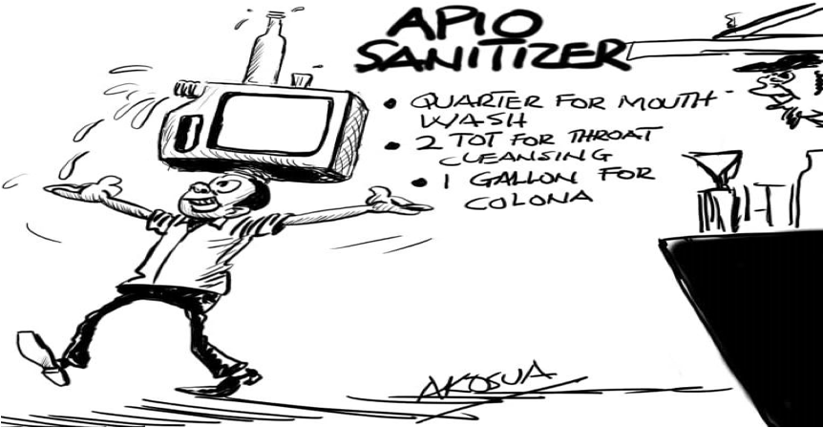
Health Communication with African Non-Profits
G. Edzordzi Agbozo, Department of English
ENG 313: Writing about Science, Medicine & the Environment
Explores genres, and techniques for accommodating science for experts and non-experts.
Interdisciplinary Learning
Understand how to integrate multiple perspectives to write and design documents
Client Project for Stand Out Care
Source: Daily Guide newspaper, Ghana
Write, design, and deliver public health documents for a primary health care non-profit in Ghana, West Africa

Slide 18
Indigenous Caribbean and Western Conceptions of Health and Illness
PAR 322: Ritual Therapy and Health in the Caribbean
Explores Caribbean perspectives (religio-cultural and biomedical) of health and illness, ethnomedical herbs, and ritual therapeutics.
Interdisciplinary learning
Understand how Caribbean cultural and Western perspectives of illness, health, and healing modalities intersect, overlap, and/or differ from each other.
Approach
Cross-disciplinary Perspectives (guest lecture) Psychology and Community perspectives from a Caribbean Ritual Expert.
The Signature Assignment
•Write and create visual image representations to demonstrate how much or little Indigenous Caribbean and Western perspectives of health, illness, and the mechanics of healing overlap, intersect or differ.

Slide 19
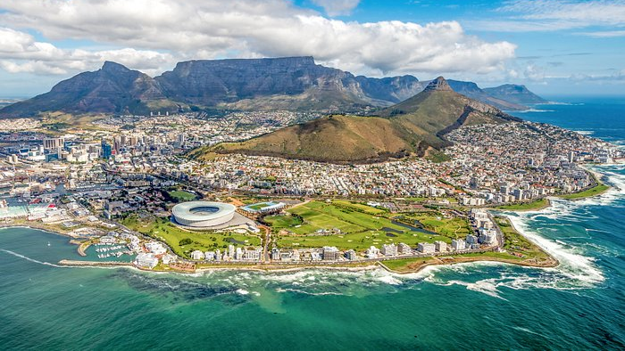
Creating Global Partnerships and Interdisciplinary Study Abroads: Migration and Empire in Cape Town
Global Citizenship
Enhancing INT315 Global Migration and Displacement
Contextualized to South Africa’s history of labor migration and empire
Guest lectures from UNCW and external faculty
Virtual reality assessment component using GoPro 360 cameras
Developing a new study abroad with the University of the Western Cape
Working with faculty, NGOs, and social justice organizers to develop a faculty-led study abroad for May 2024
Interdisciplinary field lab portfolio assessment
Interdisciplinary Learning
Theme-based interdisciplinary curricula integrating multiple methods and perspectives to critically examine challenges of migration and refugee situations in South Africa today
Collaboration with UNCW’s Upperman African American Studies Center
Diversity
Critical Thinking

Slide 20
Interdisciplinary Approaches to Applied Performance Ethnography Julie-Ann Scott-Pollock (individual grant)
COM 495: Applied Cultural Performance
The Communication, Anthropological & Theatre roots of Performance Ethnography
Hybrid Course on Performance Research Ethics and Applied Performance
Students will produce and star in a performance for community audiences about masculinity and cultural intersections
The performance will be available as a component of a peer reviewed publication for the interdisciplinary journal: Liminalities: A Journal of Performance Ethnography

Slide 21
Questions?

