Slide 1
Part 3: Advancements in Adult Learning

Slide 2
Chapter 9: New Perspectives on Andragogy

Slide 3
The Learner’s Need to Know
How learning will be conducted?
What learning will occur?
Why learning is important?

Slide 4
Self-Directed Learning
2 Conceptions of self-directed learning
  Self-teaching
  Personal autonomy

Slide 5
Grow’s Stages in Learning Autonomy
Grow's Stages in Learning Anatomy
Stage | Student | Teacher | Examples
Stage 1 | Dependent | Authority, coach | Coaching with immediate feedback, drill. Informational lecture. Overcoming deficiencies and resistance
Stage 2 | Interested | Motivator, guide | Inspiring lecture plus guided discussion. Goal-setting and learning strategies.
Stage 3 | Involved | Facilitator | Discussion facilitated by teacher who participates as equal. Seminar. Group projects.
Stage 4 | Self-directed | Consultant, delegator | Internship, dissertation, individual work or self-directed study group.

Slide 6
Garrison’s Model of Self-Directed Learning
Self-management
Control
Motivation
Entering and task
Self-monitoring
Responsibility

Slide 7
Locus of Control
Defined
  People attribute the cause or control of events to themselves or to an external environment
Internal
  Attribute control of events to themselves
External
  Attribute control to outside forces

Slide 8
Prior Experiences of the Learner
Adults’ experiences shape and inhibit new learning
Research
  “Single-loop” vs. “double-loop” learning
  “Knowing-in-action” vs. “reflection-in-action”
  Schema theory
  Information processing
  Memory research
  Constructivism

Slide 9
Learner Experience Research: Single-Loop vs. Double-Loop Learning
Single-Loop Learning
Double-Loop Learning
  Learning that fits prior experiences and existing values, which enables the learner to respond in an automatic way
  Learning that does not fit the learner’s prior experiences or schema.
  Requires learners to change their mental schema in a fundamental way

Slide 10
Learner Experience Research: Knowing-in-action vs. Reflection-in-action
Knowing-in-action
Reflection-in-action
  The somewhat automatic responses based on a person’s existing mental schema that enable him or her to perform efficiently in daily actions
  Process of reflecting while performing to discover when schema are not appropriate & changing those schema when appropriate

Slide 11
Learner Experience Research (cont.)
Schema Theory
  Schema are the cognitive structures that are built as learning and experiences accumulate and are packaged in memory
  Result = Improved individual and organizational learning and performance

Slide 12
Learner Experience Research (cont.)
Information Processing
  Prior knowledge acts as a filter to learning through attentional processes
  Result = Learners pay more attention to learning that fits with prior knowledge schema

Slide 13
Learner Experience Research (cont.)
Memory Research
  3 components of memory
    Sensory
    Short-term
    Long-term
  Experience affects sensory memory through the process of attention and selecting what information to process

Slide 14
Learner Experience Research (cont.)
Constructivism
  All knowledge is context bound, and that individuals make personal meaning of their learning experiences
  New information must be related to other existing information in order for learners to retain and use it

Slide 15
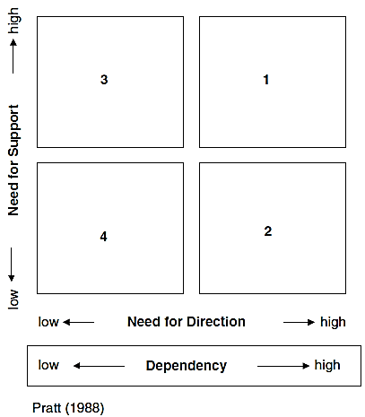
Readiness to Learn
Adults become ready to learn when their life situation creates a need to know
The more adult learning professionals can anticipate & understand adults’ life situations & learner readiness, the more effective they can be

Slide 16
Orientation to Learning and Problem Solving
Kolb’s 4 Steps in Experiential Learning Cycle
  Concrete experience
  Observations and reflection
  Formation of abstract concepts and generalization
  Testing implications of new concepts in new situations

Slide 17
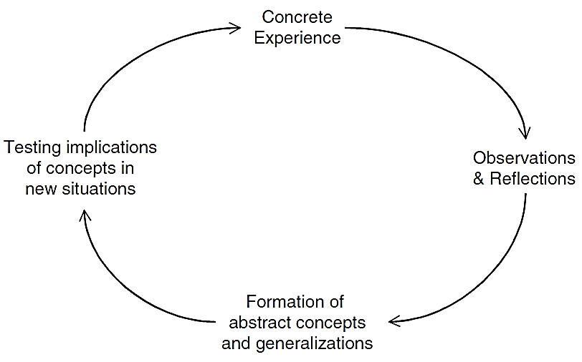
Kolb’s Experiential Learning Model

Slide 18
Motivation to Learn
Assumption of Andragogy
  Adults tend to be more motivated toward learning that helps them solve problems in their lives or results in internal payoffs
Wlodowski’s 4 Factors of Adults’ Motivation to Learn
  Success
  Volition
  Value
  Enjoyment

Slide 19
Motivation to Learn (cont.)
3 Motivation Factors of Expectancy Theory
  Valence
    Value a person places on the outcome
  Instrumentality
    Probability that the valued outcomes will be received, given that certain outcomes have occurred
  Expectancy
    Belief a person has that certain efforts will lead to outcomes that get rewarded

Slide 20
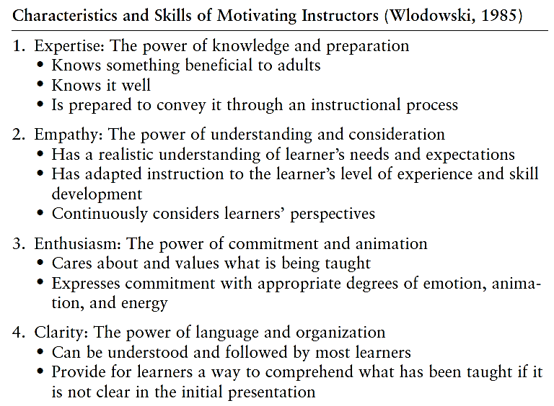
Motivation to Learn (cont.)

Slide 21
Reflection Questions
Report on a personal experience confirming the principle Learners need to know.
Report on a personal experience confirming the principle Self-directed learning.
Report on a personal experience confirming the principle Prior experience of the learner.
Report on a personal experience confirming the principle Readiness to learn.

Slide 22
Reflection Questions (Cont.)
Report on a personal experience confirming the principle Orientation to learning problem solving.
Report on a personal experience confirming the principle Motivation to learn.

