Slide 1
Part 4: Practices in Adult Learning

Slide 2
Chapter 14: Facilitating Learning

Slide 3
Roles of Teachers
Transmit prescribed content
  What students should learn
Control the way students receive and use it
  How and when students should learn
Test if they have received it
  If students have learned

Slide 4
Teacher Characteristics
Key skills
Presentation
Source of rewards
Being such a good transmitter of content
Controlling students

Slide 5
Roles of Learning Facilitators
Process manager
Process designer
Content resource

Slide 6
Facilitator Characteristics
Relationship building skills
Needs assessment skills
Involvement of students in planning
Linking students to learning resources
Encouraging student initiative
Required skills
Source of reward
Releasing students

Slide 7
Creative Leadership
The highest function of leadership
Releases the creative energy of the people being led

Slide 8
Behavioral Characteristics of Creative Leaders
Have faith in people, offer them challenging opportunities, and delegate responsibility to them
Involve their clients in all of the planning process
Believe in and use the power of self-fulfilling prophecy
Value individuality

Slide 9
Behavioral Characteristics of Creative Leaders (cont.)
Stimulate and reward creativity
Committed to a process of continuous change and are skillful in managing change
Emphasize internal motivators over external motivators
Encourage people to be self-directing

Slide 10
Theory X
Theory Y
Assumptions about Human Nature
  The average person dislikes work & will avoid it if he can
  Most people must be coerced, controlled, & threatened in the interest of organizational objectives
  The average person prefers to be directed, wishes to avoid responsibility, has relatively little ambition, & wants security above all
Assumptions About Human Nature
The expenditure of physical and mental effort is as natural as play or rest.
External control and threat of punishment are not the only means for bringing about effort toward organizational objectives. Man will exercise self-direction and self-control in the service of objectives to which he is committed.
Commitment to objectives is a function of the rewards associated their achievement.
Assumptions Implicit in Current Education
  The student cannot be trusted in his own learning
  Presentation equals learning
  The aim of education is to build brick upon brick of factual knowledge
  The truth is known
  Creative citizens develop from passive learners
  Evaluation is education & education is evaluation
Assumptions Relevant to Significant Experiential Learning
Human beings have a natural potentiality for learning
Significant learning takes place when the subject matter is perceived by the student as relevant to his own purposes
Much significant learning is acquired through doing.
Learning is facilitated by student’s responsible participation in the learning process
10
10

Slide 11
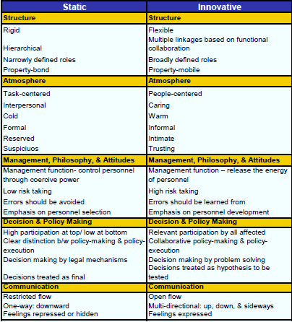
Organization Characteristics

Slide 12
Reflection Questions
What are the barriers to succeeding as a facilitator?
Given that there are times you need to be a teacher and other times a facilitator, what would you need to do to mentally prepare yourself for each role?
Discuss and contrast the concepts of controlling and releasing the energy of others.
Why is leadership important in releasing the energy of others?
What strikes you most when you compare and contrast static and innovative organizations?

