Slide 1
Part I: Adult Learning

Slide 2
Chapter 5: Andragogy in Practice

Slide 3
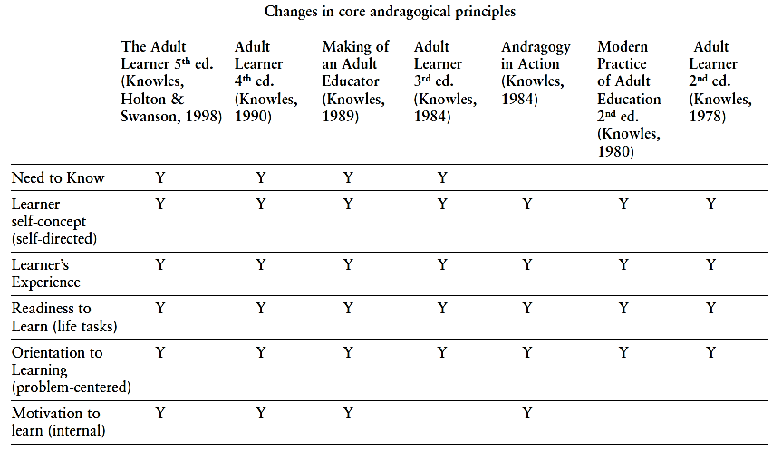
History of Andragogical Assumptions

Slide 4
Theorists’ Criticisms of Andragogy
  Focus only on individual
No critical social agenda
Doesn’t debate the relationship of adult education to society
Hasn’t adopted
  Critical philosophical perspective
  Critical paradigm of adult learning

Slide 5
An Individual-Transactional Framework
  Central concern of andragogy
  How the adult learning transaction occurs

Slide 6
Application of Andragogy
Essential feature
  Flexibility
Implemented in:
  Part
  Whole
Strategies are situational

Slide 7
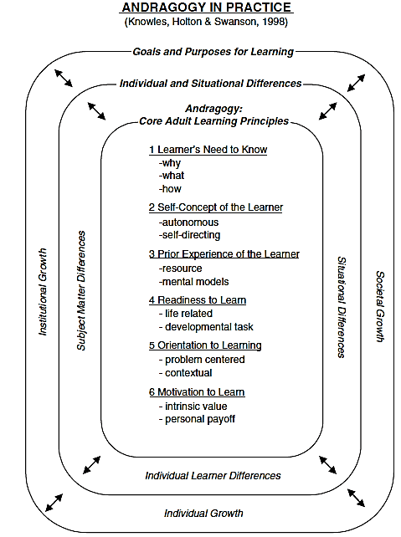
The Andragogy in Practice Model

Slide 8
Goals and Purposes for Learning
Institutional Growth
Societal Growth Individual Growth

Slide 9
Differences that Impact Adult Learning
Situational differences
Individual differences
Subject-matter differences

Slide 10
Subject-matter differences
Different subject matter may require different learning strategies
Not all subject matter can be taught or learned in the same way

Slide 11
Situational differences
Defined
  Any unique factors that could arise in a particular learning situation
  Sets of Influences
Micro-level differences
Local situations dictate different learning/ teaching strategies
Broader level differences
Connects andragogy with socio-cultural influences of each situation
Situational influences before learning
Cultural differences, learning history, etc.
Situational influences during learning
Social, cultural, and situation-specific factors that may alter the learning transaction

Slide 12
Individual Differences
Cognitive Differences
Personality Differences
Prior Knowledge Differences

Slide 13
Individual Differences (cont.)
Cognitive Differences
Personality Differences
General Mental Abilities
Primary Mental Abilities
Cognitive Controls
Cognitive Styles: Information gathering
Cognitive Styles: Information Organizing
Learning Styles
Personality: Attention and engagement styles
Personality: Expectancy and incentive styles

Slide 14
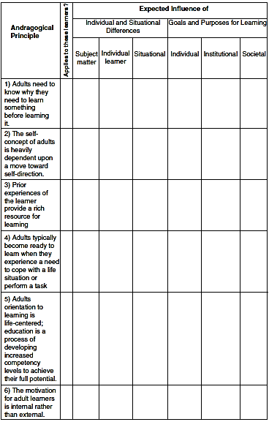
Applying the Andragogy in Practice Framework

Slide 15
Reflection Questions
Discuss the ideas of adult learning and adult education and adult education and the implication of the differences.
Do you see andragogy’s focus on the learning transaction versus the goals and content of adult learning as a strength or a weakness? Discuss your position.
Discuss the ability of the andragogy in practice figure from a practitioner perspective.
Discuss the case examples by simply changing two of the specific influences (two of the cells) that could radically impact on the learning approach to be taken.

