Slide 1
Part 4: Practices in Adult Learning

Slide 2
Chapter 15: Some Guidelines for Using Learning Contracts

Slide 3
Learning Contracts
Why use learning contracts?
  Provides an understanding between the organization and the learner to achieve mutual goals
  Learner develops a sense of ownership/ commitment to plan
  Clarifies learning objectives clear for the learner and supervisor

Slide 4
How to Develop a Learning Contract
Step 1
Step 2
Step 3
Step 4
Step 5
Step 6
Step 7
Step 8
Diagnose your learning needs
Specify your learning objectives
Specify your learning resources and strategies
Specify evidence of accomplishment
Specify how the evidence will be validated
Review your contract with consultants
Carry out the contract
Evaluate your learning

Slide 5
Key Terms
Learning need
  The gap between where you are now and where you want to be in regard to a particular set of competencies
Competency
  The ability to do something at some level of proficiency
  Usually composed of a combination of knowledge, understanding, skill, attitude, and values

Slide 6
Step 1
Diagnose your learning needs
  Construct a model of the competencies required to perform the role excellently
  Assess the gap between where you are now and where the model says you should be in regard to each competency

Slide 7
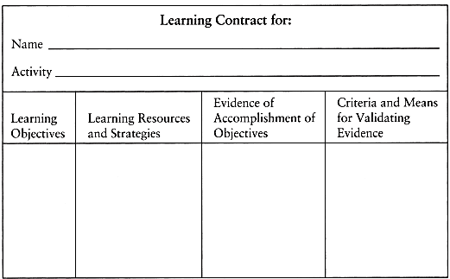
Step 2
Specify your learning objectives
  Translate each of the learning needs diagnosed in Step 1 into a learning objective
  Describe what you will learn, not what you will do

Slide 8
Step 3
Specify your learning resources and strategies
  Describe how you propose to go about accomplishing each objective
  Identify the resources you plan to use
  Identify the strategies you will employ

Slide 9
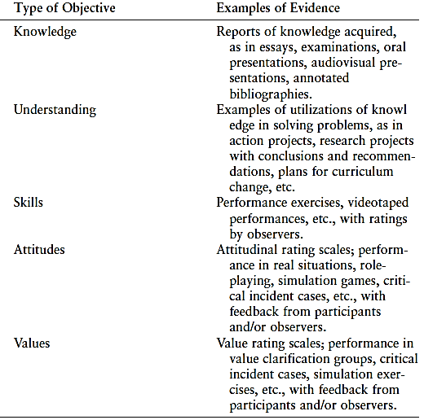
Step 4
Specify evidence of accomplishment
  Describe what evidence you will collect to indicate the degree to which you have achieved each objective

Slide 10
Step 5
Specify how the evidence will be validated
  For each objective
    Specify the judging criteria for each objective
    Indicate how the evidence will be judged according to these criteria
    Who will judge, how are they qualified

Slide 11
Step 6
Review your contract with consultants
  Questions to ask about the contract for optimal benefit
    Are the learning objectives clear, understandable, and realistic; and do they describe what you propose to learn?
    Can they think of other objectives you might consider?
    Do the learning strategies and resources seem reasonable, appropriate, and efficient?
    Can they think of other resources and strategies you might consider?
    Does the evidence seem relevant to the various objectives, and would it convince them?
    Can they suggest other evidence you might consider?
    Are the criteria and means for validating the evidence clear, relevant, and convincing?
    Can they think of other ways to validate the evidence that you might consider?

Slide 12

Step 7
Carry out the contract
  Do what the contract calls for
  Revise your contract as you go along

Slide 13
Step 8
Evaluate your learning
  Have consultants examine your evidence and validation data and give their judgment about its adequacy

Slide 14
Reflection Questions
What are the steps in creating a contract?
What learning contract step or steps do you think give learners the most difficulty?

