Slide 1
Part 2: The Backdrop of Learning and Teaching Theories

Slide 2
Chapter 8: Adult Learning within Human Resource Development

Slide 3
Human Resource Development Goals
Individual Focus First
Organizational focus first
  Individual development and personal fulfillment without using organizational performance as the measure of worth
Increase the performance of the host organization through the development of the organization’s workforce

Slide 4
HRD Goals (cont.)
Important Elements in HRD
  Performance outcomes
    Ex: High-quality services delivered to external customers
  Performance drivers
    Ex: Learning and process improvement
HRD should be concerned with maintaining and/or improving performance

Slide 5
HRD Goals (cont.)
Key Terms
    Organization
    A productive enterprise having a mission and goals
    A system, with definable inputs, processes, outputs, parts, and purposes
    Performance
    The means by which organizations measure their goals
    Can be measured at the organizational, process, and individual levels

Slide 6
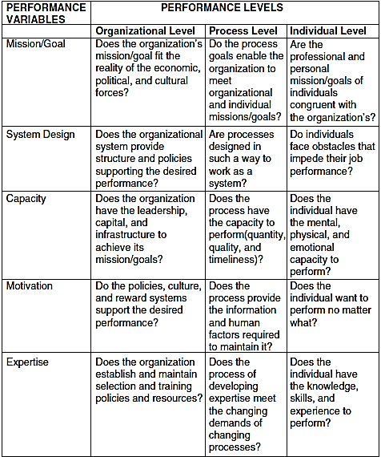
HRD and Performance Improvement
Notes:
Performance diagnosis matrix of enabling questions

Slide 7
HRD and Performance Improvement (cont.)
Strategic Capability
  Defined: Knowledge & expertise required to figure out the present and future developments & finding ways to connect them
Adult Learning
  Critical to
    Maintain performance of an existing system
    Improve system performance
  Powerful organizational improvement strategy

Slide 8
HRD and Adult Learning (cont.)
Focus of Adult Learning in HRD
  Development interventions
    Organizational context
    Desired outcome is learning that will impact the organization’s performance goals

Slide 9
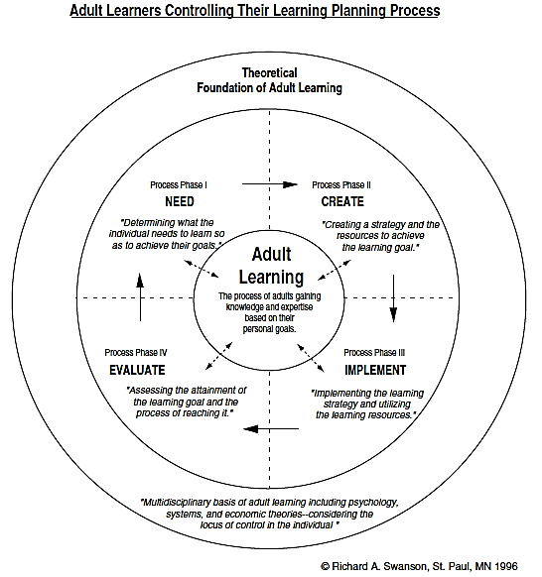
Phases of the Adult Learning Planning Process

Slide 10
The Adult Learning Planning Process: Need
“Who needs to know, as defined by whom?”
Advice
  Engage learners in this phase to gain higher motivation.
  Do not expect self-reported needs to be accurate for either the individual or the organization.

Slide 11
The Adult Learning Planning Process: Need (cont.)
Type of Learning
Unintended learning
Self-directed learning
Mediated learning
Locus of Control
No control
Learner controlled
Shared control b/w learner and external authority
Authority-directed learning
Authority controlled

Slide 12
The Adult Learning Planning Process: Create
Educators engage learners to
  Establish motivation & community
  Promote validity of the experience & materials
Advice
  Engage learners in this phase to better mediate the actual learning

Slide 13
The Adult Learning Planning Process: Implement
Forms of shared control
  Formative evaluation
  Team learning
  Peer instruction
Advice
  Engage learners in this phase to gain higher validity in the selected learning strategies

Slide 14
The Adult Learning Planning Process: Evaluate
Evaluation
  Defined: “a systematic collection of evidence to determine if desired changes are taking place”
Advice
  Engage learners in this phase to gain higher self-reflection and integration of the knowledge and expertise being sought.

Slide 15
Reflection Questions
Discuss how both disciplines of adult education and human resource development connect to adult learning.
From your experience, how does learning connect with performance? Speak to performance at various levels (individual, work process, and organization).
What is your general position related to the idea of adult learners controlling their own learning?
Discuss the relative ease and difficulty of adults controlling the various learning phases (need, create, implement, and evaluate).

